Slide 1
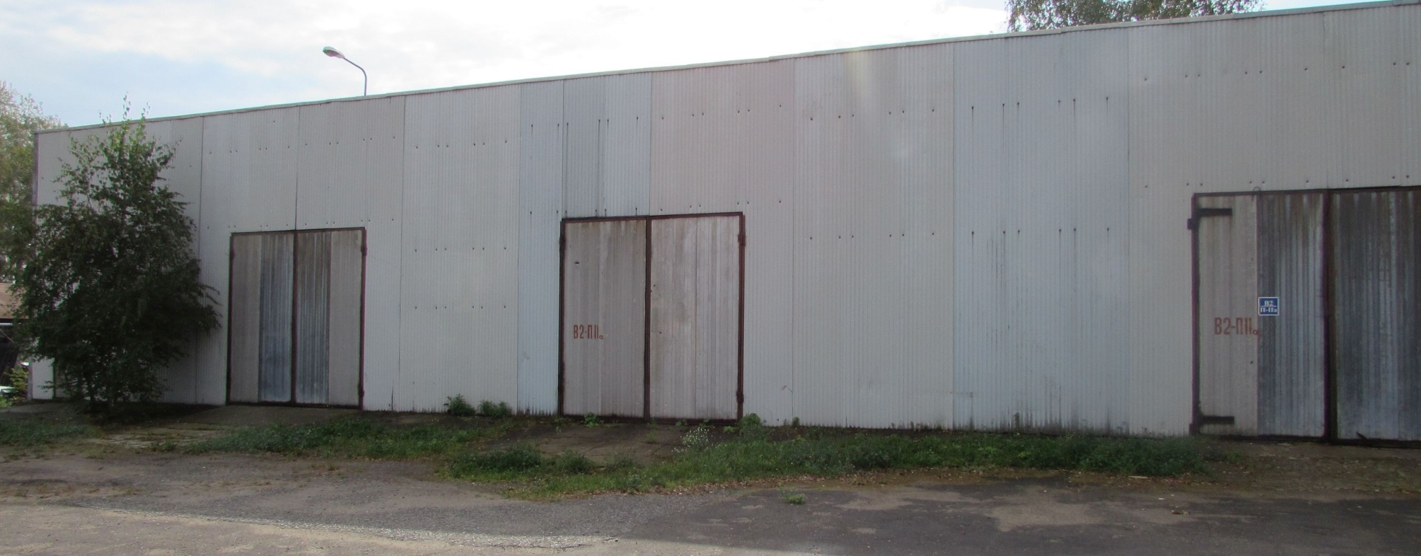
INVESTMENT OPPORTUNITY: sale of production and warehouse complex at the address: Moscow region, Lyubertsy district, village Tokarevo, building 1.

Slide 2
The main parameters of the Object
Building Characteristics
Lit.A: non-residential, 2-storey, brick, 1987, area 1994.3 sq.m. (frame number 50:22:04:02661:011)
Lit. B: non-residential, Warehouse, brick, 1984, area 712.4 sq.m. (frame number 50:22:04:02661:001)
Lit.V: non-residential, Boiler room, reinforced concrete slabs, 1984, area 87.3 sq.m. (frame number 50:22:04:02661:002)
lit. D: non-residential, Workshops, brick, 1962, area 229.9 sq.m. (frame number 50:22:04:02661:003)
Lit.E: non-residential, Warehouse-barracks, reinforced concrete slabs, 1962, area 467.1 sq.m. (frame number 50:22: 04:02661:004)
Lit.F: non-residential, Garage with a boiler room, brick, 1962, area 465.6 sq.m. (frame number 50:22:04:02661:005)
lit. K: non-residential, LVZH Warehouse, reinforced concrete slabs, 1984, area 84.3 sq.m. (frame number 50:22:04:02661:006)
lit. L: non-residential, Finished goods warehouse, metal structures, 1984, area 468.6 sq.m. (frame number 50:22:04:02661:007)
Lit. N, N1: non-residential, Checkpoint, reinforced concrete slabs, 1984, area 54.1 sq.m. (frame number 50:22:04:02661:009)
Lit.O: non-residential, Assembly and procurement section, metal structures, 1984, area 495.7 sq.m. (frame number 50:22:04:02661:010)
lit. G4: non-residential, Plot of mechanization, metal construction, 1984, area 61.7 sq.m. (frame number 50-50-22 / 068 / 2010-197)
lit. M: non-residential, Hangar, metal, 1984, area 451.5 sq.m. (frame number 50:22:04:02661:008)
Production and warehouse complex at the address: Moscow region, Lyubertsy district, Tokarevo village, building 1. 11 capital buildings with a total area of ​​5 510.8 sq.m. in the property. Land plot with an area of ​​ 34 111 sq.m. in the property. Land characteristics land category: lands of settlements. cadastral number: 50:22:0040514: 30 total area: 34 111 sq.m. permitted use: for production activities. The soil in the territory is represented by cover loam, sandy moraine, loamy moraine. The soil, according to the mechanical composition, is light loamy, moisture-intensive, has a low absorption capacity. Usage Profile Storage of goods, production of specialized products, rental. Communications Well with a water tower, heating, electricity (permissible power up to 85 kW), own gas network, Internet, fire alarm.
* cadastral number http://roscadastr.com/map

Slide 3
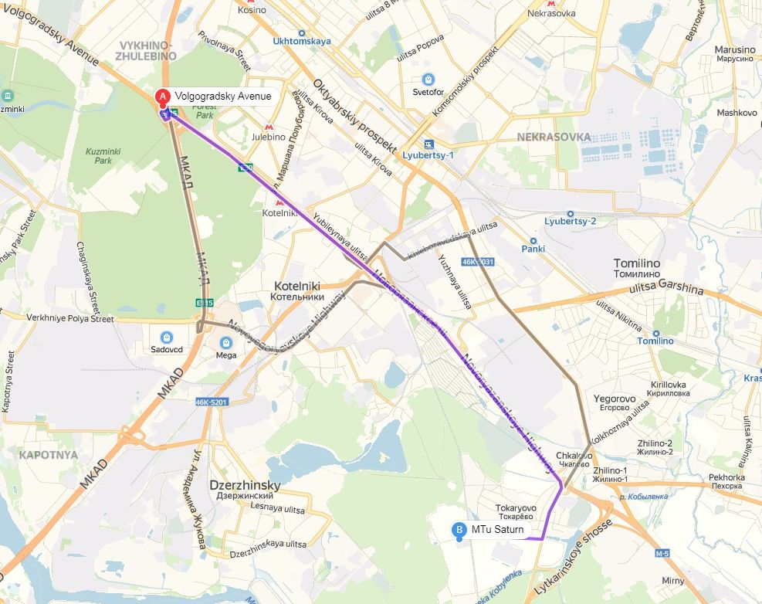
1. The location of the production and warehouse complex
Excellent transport accessibility of the object: the proximity of major highways, convenient access and the possibility of parking.

Slide 4
2. Key advantages of the production complex
1
Possibility of use for the organization of production and for storage
2
Ability to use both for your own business and for renting
3
Excellent transport accessibility (2 km to Novoryazanskoe highway, 13 km to the Moscow Ring Road)
4
The land is flat, without significant changes in relief, the territory is partially paved, fenced, lit.
5
Power given out by the transformer (100 kW)
6
Extensive private territory
7
Наличие собственной котельной

Slide 5
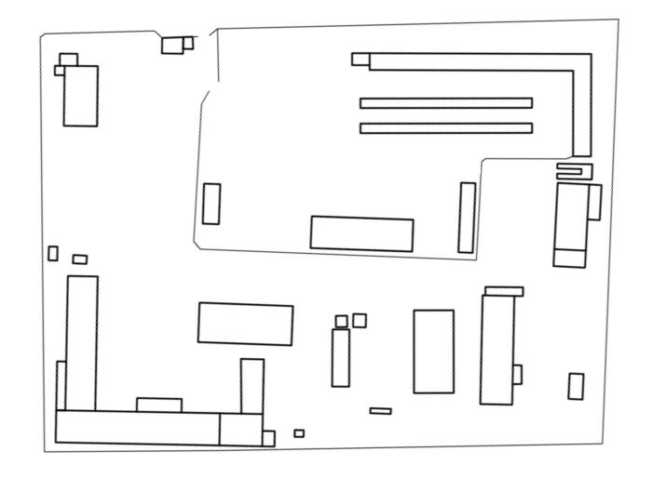
3. Plan-scheme
Н
Б
Д
К
Ж
Л
О
В
М
Е
Г
А

Slide 6
4. Basic engineering networks. Description.
Electrosupply
Power-supply of the facility 3.
The power supply is carried out as follows: Main power: substation # 2 "Kraskovo" RU-6 kV feeder 16B, RTP No. 14, the feeder direction for the TA-308 TA-308. Power is supplied by overhead lines 3(A-50 mm2) up to the borders of balance accessory and operational responsibility. Connection to electric networks is carried out in the following points: 6 kV ТП249 – ТП307. The nominal voltage at the point of demarcation 6000 Volts.
TP - 308 is connected to electrical networks with wires SIP-3(1х70) in length, 45 meters.
Allowed electrical capacity of 85 kVA.
In the case of increasing the allowed electric power by the consumer will need:
- replace the transformer (100 kVA) for a more powerful.
- to increase the cross section SIP-3(1х70) overhead lines running a distance of 45 m.
Heat supply
The object is supplied with heat from a gas boiler designed to provide heat to heating systems and hot water. Boilers: 3 Mighty Therm HH-1200 boilers, power 284.8 kW each.
Thermal loads on the boiler room are:
Heating. Heat carrier T = 95-70 ° C. The amount of heat is 0.386 Gcal / hour.
Hot water supply. Hot water T = 60 ° C. The amount of heat is 0.082 Gcal / hour.
Fuel is natural gas. The maximum hourly gas flow rate is 97.2 m³ / h.
The gas supply agreement of Gazprom Mezhregiongaz Moscow LLC No. 61-8-0850 / 13 of 10.25.2012. The annual volume of gas supply is 165.876 thousand m³.
Water supply
The water intake unit includes one production well No. 1 / GVK-46211447 (license MSK 02134 VE dated 01.26.2009), one water tower (12m³), water supply network.
Allowed water consumption is 3 cubic meters / day.
Sewage system
The sewer system is made by cesspools.
On the territory there are 3 underground metal tanks for collecting concrete goods connected with the sanitary units of the complex (1 - 27m³; 2 - 12m³; 3 - 8m³).
Export and disposal are carried out by the company “Formula Ecologii”.

Slide 7
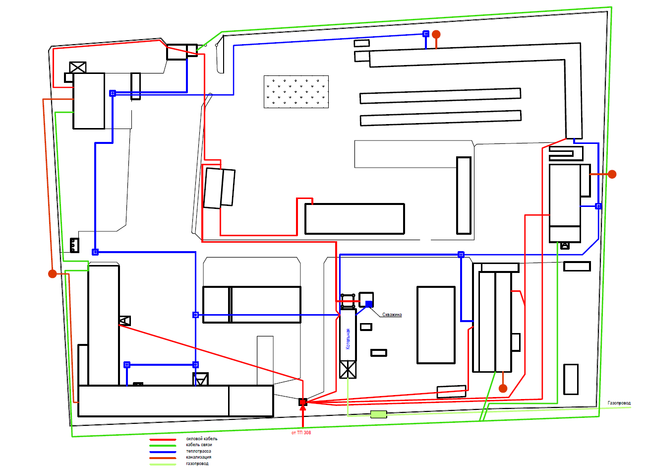
4.1 communication Scheme

Slide 8
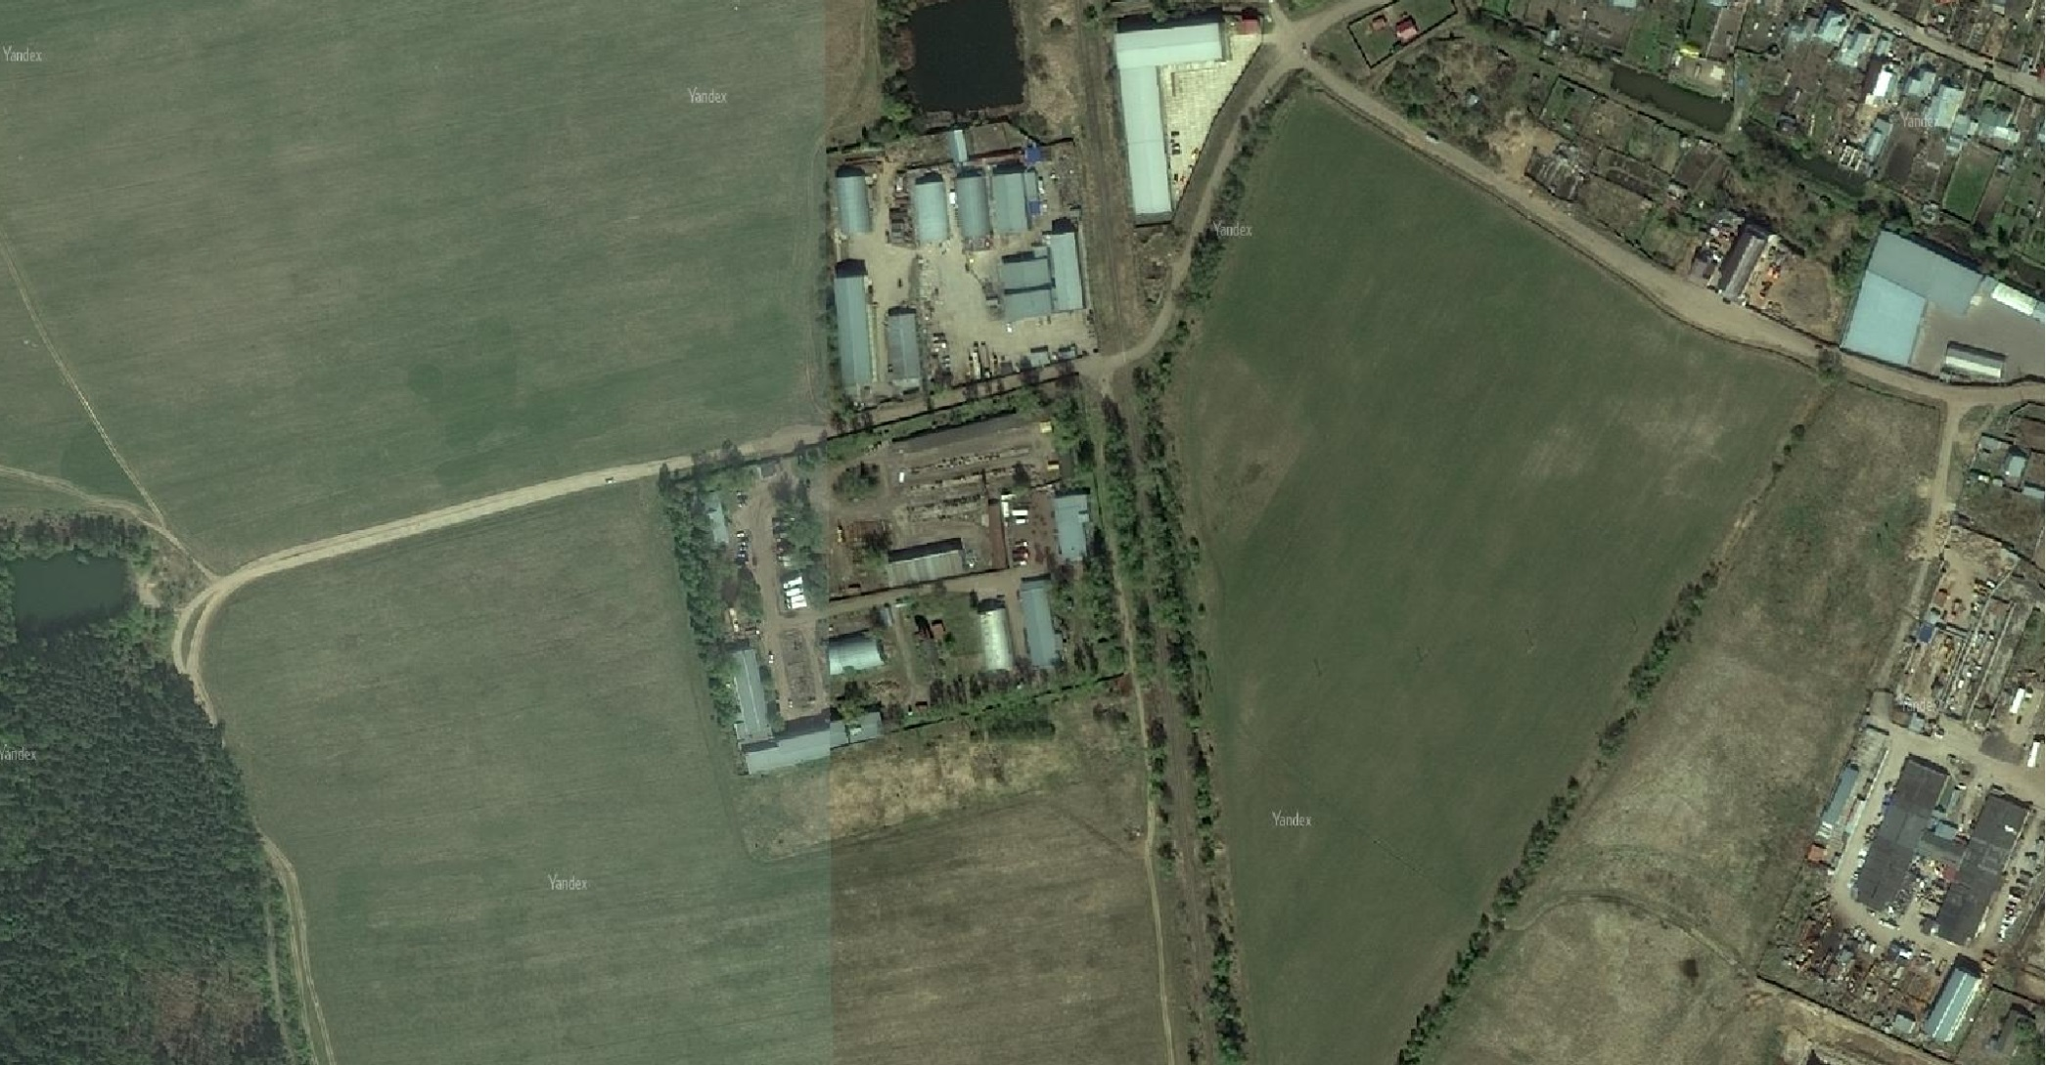
Satellite photo of the complex

Slide 9
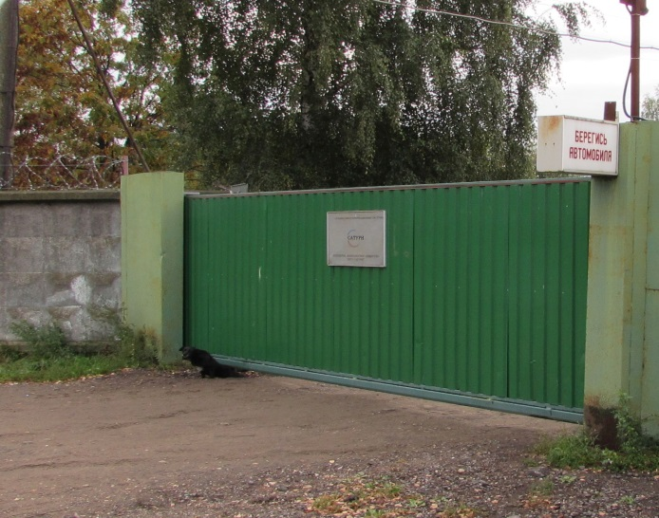
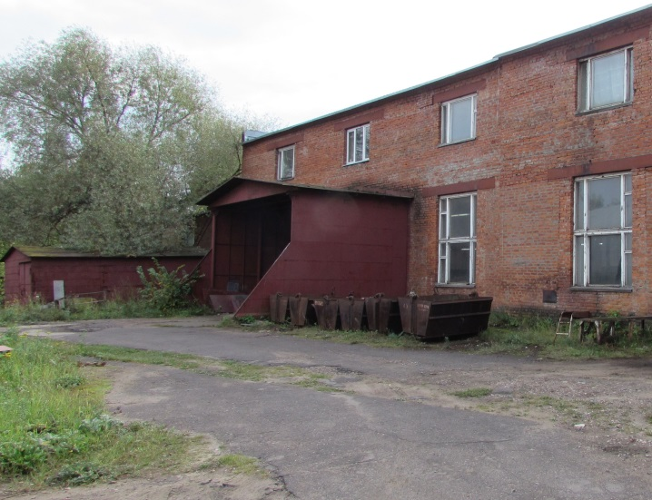
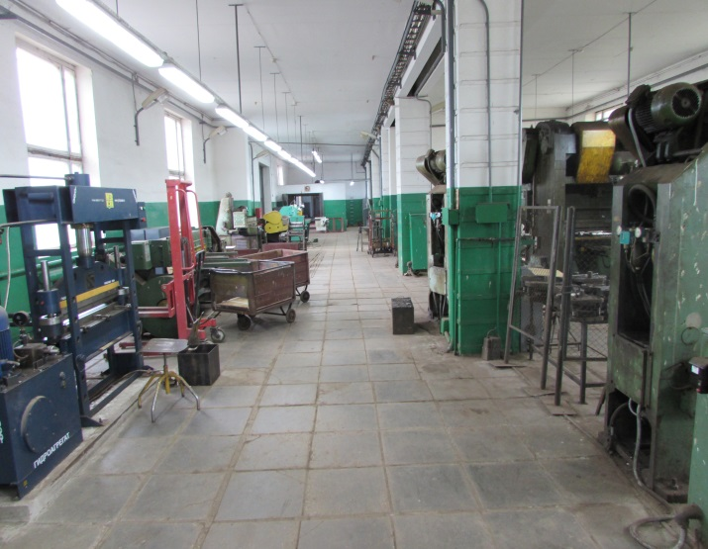
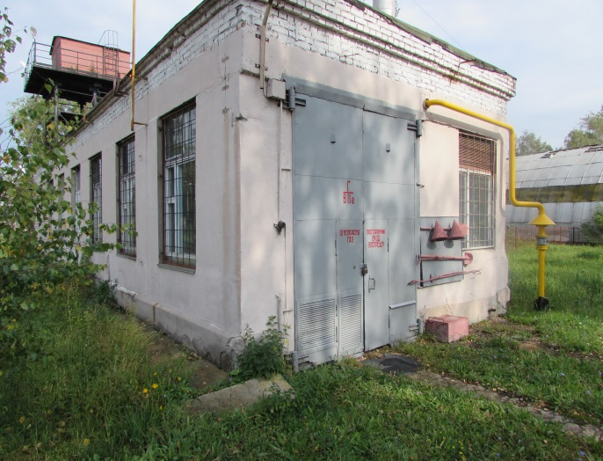
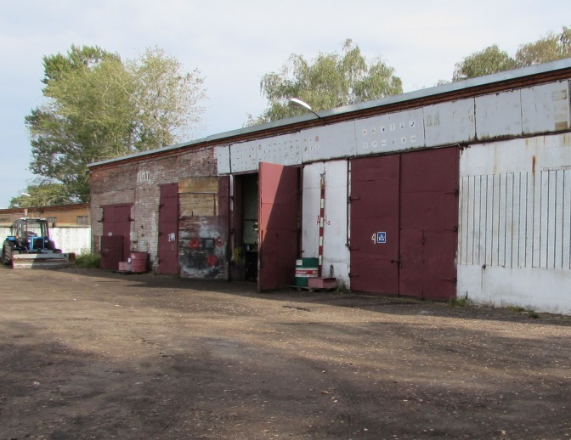
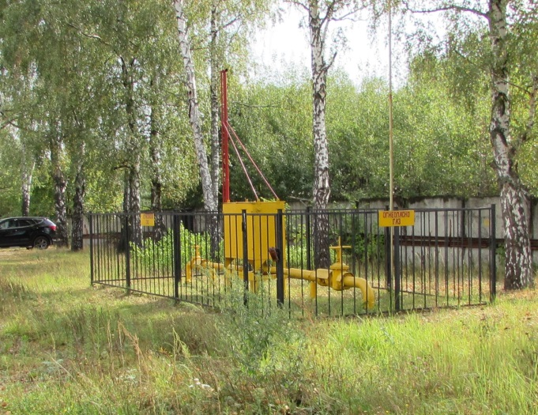
Appendix 1. Photo.
Entrance
Building Lit. А
Production hall
boiler house
Garage
Gas pipeline in the territory

Slide 10
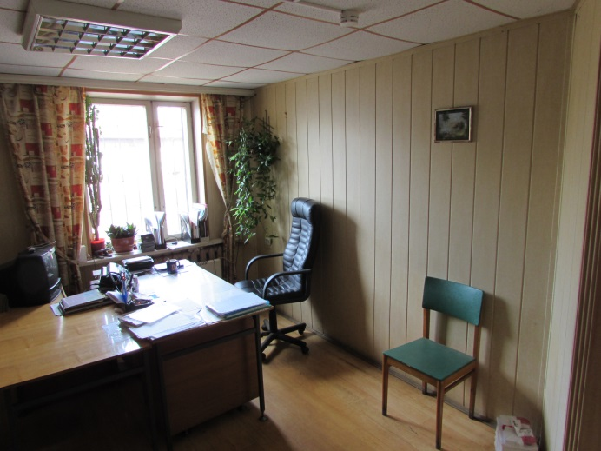
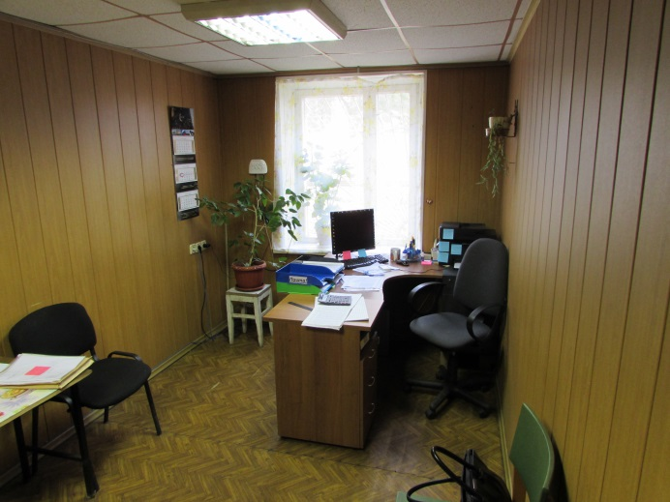
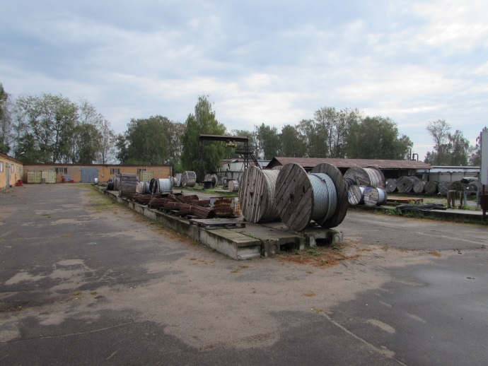
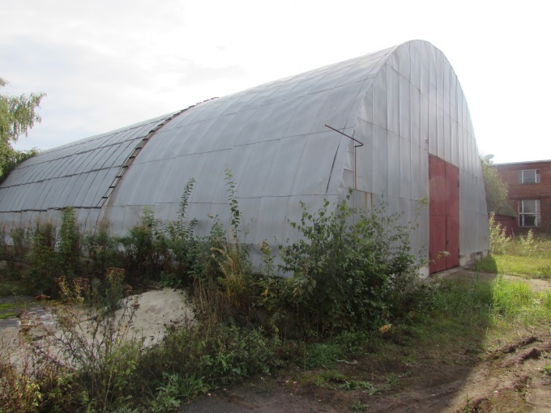
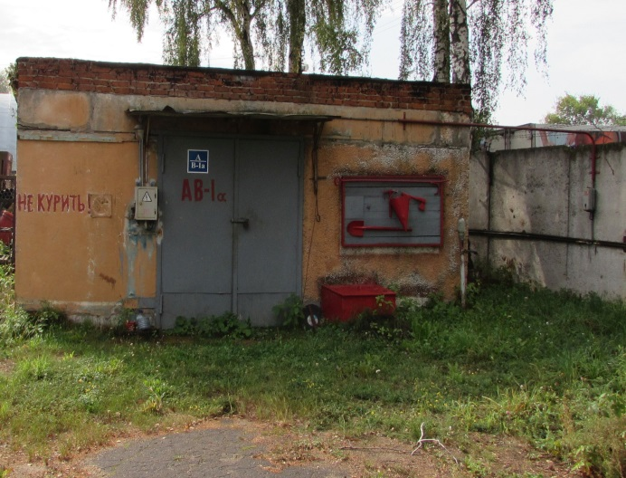
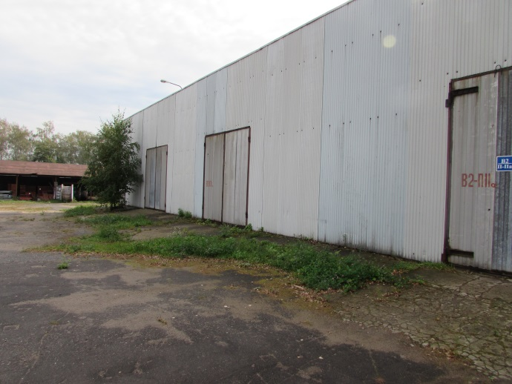
Appendix 2. Photo.
Office rooms
Office rooms
Outdoor area
Building lit.O
Warehouse LVZh lit. K
Warehouse lit.L

